Slide 1
Unlocking Economic Potential: The Impact of Fertility Rate on GDP per Capita in Nigeria and African Nations Using Insights from High-Income Countries
.
PRESENTED BY FAVOUR AKPAN favourina.akpan@gmail.com

Slide 2
Problem Statement
Nigeria and many African nations face a development puzzle: High fertility rates lead to a young population, but economic growth (GDP per capita) remains low. This begs the question: How can African countries unlock their economic potential?
This report takes a unique approach. We examine high-income countries, nations that have achieved remarkable economic success. By analyzing their fertility rates, median age, Life expectancy rates, mortality rates and GDP per capita, we can identify strategies that might be applicable to the African context.
Imagine a future where Nigeria and other African countries thrive. A skilled workforce fuels economic growth, creating a prosperous future for all. This report is your roadmap to achieving that vision.

Slide 3
Objective
This report equips policymakers, development agencies, and NGOs with the knowledge to:
Craft data-driven policies that address fertility rates in a way that fosters economic growth.
Allocate resources effectively towards initiatives that create a skilled and productive workforce.
Develop strategies for attracting investment and fostering sustainable economic development in Africa.
Join us on this journey to unlock the economic potential of Nigeria and Africa!

Slide 4
Defining Key Terms for Economic Analysis
Fertility Rate: A Measure of Population Growth. It’s the average number of children a woman is expected to have in her lifetime. High rates mean more children per woman, while low rates mean fewer.
Median Age: The Age Structure of a Population. It’s the age that splits a population in half—half are younger, half are older. A high median age indicates an aging population, while a low median age suggests a younger one.
GDP per Capita: A Measure of Economic Well-being. It’s the average income per person in a country, calculated by dividing the total GDP by the population. High GDP per capita typically indicates a higher standard of living, while a low figure is often associated with poverty and limited access to basic needs.
Life Expectancy Rate: The average number of years a person can expect to live based on current conditions. It reflects a population's health, quality of life, and the effectiveness of healthcare and living standards.
Under-5 Mortality Rate: The number of deaths of children under five years old per 1,000 live births in a year.

Slide 5
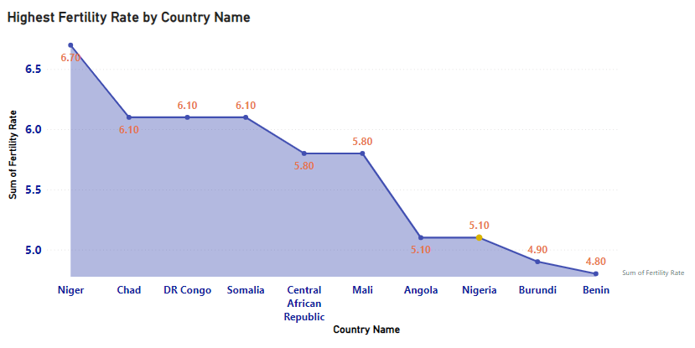
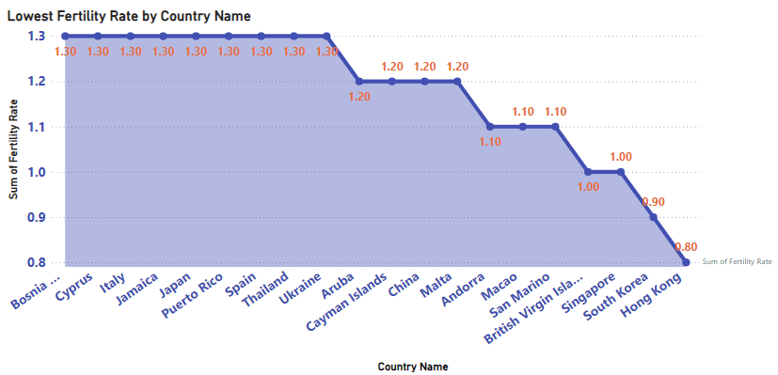
Fertility Rate
These Countries share a distinct characteristic: they are all located in Sub-Saharan Africa and are among the world's poorest nations.
Hong Kong, South Korea, Singapore, Macao, Andorra, Malta, Cayman Islands: These regions are known for their high levels of economic development, advanced infrastructure, and high standards of living.

Slide 6
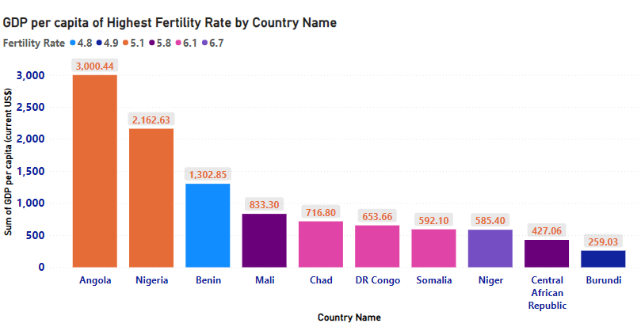
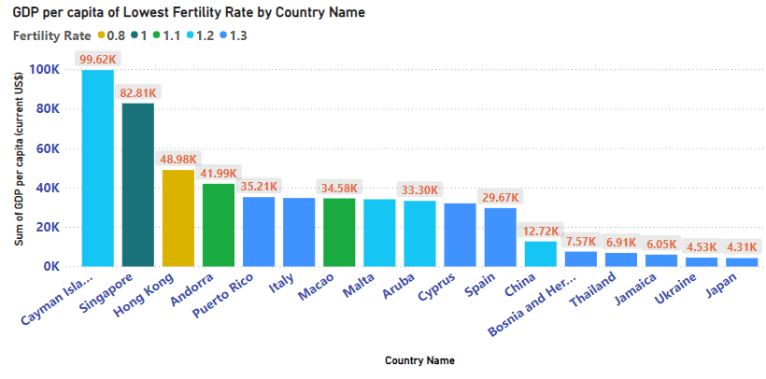
Fertility Rate & GDP Per Capita
The countries with the highest fertility rates have a GDP per capita range of $259 to $3000 while the countries with the lowest fertility rates have a GDP per capita range of $4,300 to $99,000.
The data suggests a strong inverse correlation between GDP per capita and fertility rate.
In simpler terms, countries with lower fertility rates, tend to have higher GDP per capita while those with higher fertility rates generally have lower GDP per capita.

Slide 7
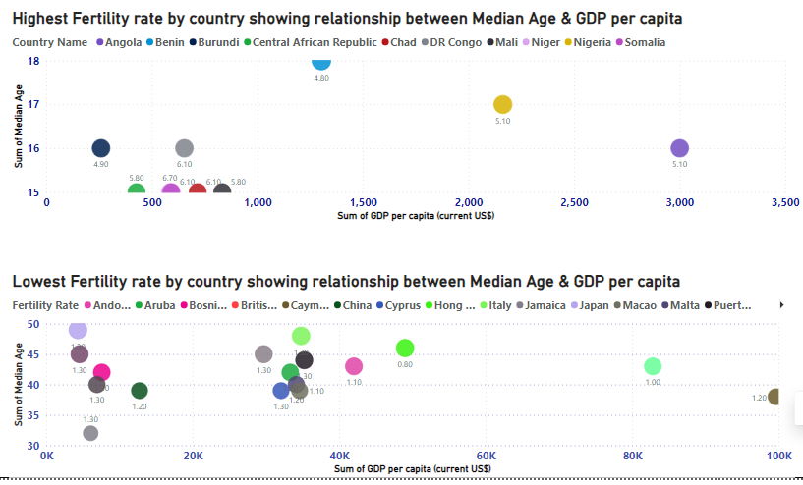
Fertility Rate, Median Age & GDP Per Capita
These countries with high fertility rate, low median age and low GDP per capita are characterized by a demographic profile referred to as a "youth bulge."
In contrast, countries with low fertility rates, high median age, and high GDP per capita are predominantly developed nations.

Slide 8
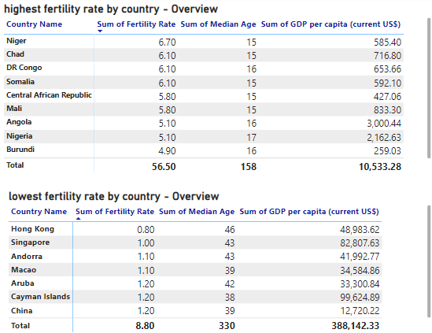
Overview of the Key Indices
Key Indices | Sub-Saharan Africa | Developed Countries
Demographic Profile | Youth bulge: High fertility, low median age | Low fertility, high median age
Fertility Rates | High: Large families for labor and social security, influenced by cultural norms, religious beliefs, and limited access to family planning | Low: Urbanization, women's education, access to contraception, and changing societal values
Median Age | Low: High proportion of young people, presenting challenges where majority of the population are dependents, therefore, not productive members of society. | High: Declining birth rates and increasing life expectancy.
GDP per Capita | Low: Agrarian economies, limited industrialization, reliance on primary commodities, rapid population growth, high poverty rates, and underdevelopment | High: Industrialization, technological advancement, economic growth, higher standards of living

Slide 9
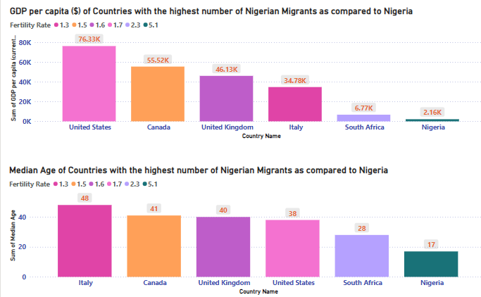
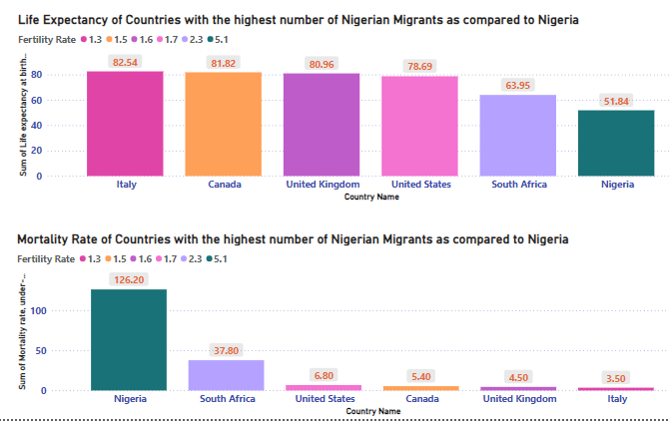
Fertility Rate in Nigeria and The ‘Japa’ Syndrome

Slide 10
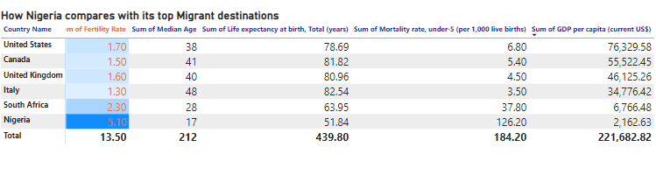
Comparison
Fertility Rate: Nigeria has a much higher fertility rate compared to other countries, which has contributed to a high population growth rate.
Median Age: The median age in Nigeria is 17, indicating a very young population compared to the other countries which have median ages ranging from 28 (South Africa) to 48 (Italy).
Life Expectancy: At 51.84 years, Nigeria’s life expectancy is much lower than the other countries, suggesting significant public health challenges.
Under-5 Mortality Rate: Nigeria has a very high under-5 mortality rate of 126.20 for every 1000 births, indicating severe issues in child health services and overall healthcare infrastructure.
GDP per Capita: Nigeria's GDP per capita is $2,162.63, far below the others, pointing towards lower economic prosperity and standard of living.

Slide 11
Correlation Analysis
Is there a significant link between the Fertility rate and the other indices captured?
Indicator | Nigeria (Fertility Rate of 5.1) | Observation (Fertility Rate vs. other indicators | Conclusion
Median Age | 17 | Higher fertility rates tend to correspond with lower median ages. Example: Nigeria (5.1, 17), Italy (1.3, 48). | Inverse relationship (higher fertility rates are associated with younger populations)
Life Expectancy at Birth | 51.84 | Higher fertility rates tend to correspond with lower life expectancies. Example: Nigeria (5.1, 51.84), Italy (1.3, 82.54). | Inverse relationship (higher fertility rates are associated with lower life expectancy)
Under-5 Mortality Rate | 126.2 | Higher fertility rates tend to correspond with higher under-5 mortality rates. Example: Nigeria (5.1, 126.2), Italy (1.3, 3.4). | Positive relationship (higher fertility rates are associated with higher under-5 mortality rates)
GDP per Capita (US$) | 2,162.63 | Higher fertility rates tend to correspond with lower GDP per capita. Example: Nigeria (5.1, $2,162.63), US (1.7, $76,329.58). | Inverse relationship (higher fertility rates are associated with lower GDP per capita)

Slide 12
Improving indices such as fertility rate, median age, life expectancy, mortality rate, and GDP per capita would have a profound positive impact on Nigeria. Here's a breakdown:
Category | Positive Effects
Economic Benefits | Increased productivity from a healthier workforce
 | Higher GDP per capita and better living standards
 | Attraction of foreign investments
Health Benefits | Reduced mortality rates
 | Improved public health and healthcare infrastructure
 | Enhanced quality of life
Social Benefits | Higher educational attainment due to better health
 | Greater social stability and reduced crime rates
 | Increased gender equality and opportunities for women
Demographic Benefits | More balanced population growth and resource management
 | Preparedness for an aging population
Environmental Benefits | Promotion of sustainable development and environmental conservation
Global Standing | Improved international reputation
 | Better compliance with global development goals (e.g., UN SDGs)

Slide 13
Here are Tailored Recommendations to reduce Nigeria’s high Fertility Rate for a healthier and more prosperous stable society:
Healthcare Reforms:
Invest in healthcare infrastructure, especially in rural areas.
Train more healthcare workers and ensure the availability of essential medicines and vaccines.
Educational Initiatives:
Provide scholarships and build schools, particularly for girls.
Ensure girls stay in school to lower fertility rates and improve economic outcomes.
Economic Empowerment:
Create jobs and promote entrepreneurship.
Invest in key sectors like technology, agriculture, and manufacturing.
Family Planning and Reproductive Health:
Increase access to family planning services and contraceptives.
Conduct public awareness campaigns on the benefits of family planning.
Public Health Campaigns:
Educate the public on preventive healthcare measures such as vaccinations and sanitation.
Social Protection Programs:
Implement social safety nets and welfare programs to reduce poverty and inequality.
Policy and Governance:
Strengthen governance and ensure policies are data-driven and effectively implemented.
Promote transparency and accountability in government initiatives.

Slide 14
Conclusion
High fertility rates hinder Nigeria and Africa's economic progress. A larger, younger population strains resources, limiting investments in education and healthcare.
In contrast, high-income countries achieved economic growth alongside declining fertility rates.
Lowering fertility can boost economic growth by creating a more productive workforce and reducing dependency burdens.
Investing in women's education, healthcare, and economic opportunities is crucial to achieving this.
Ultimately, addressing high fertility is essential for Nigeria and Africa to unlock their economic potential.

Slide 15
Sources (References)
Countries with the lowest and highest fertility rates 2024 – Statista - www.statista.com
https://data.worldbank.org/indicator/NY.GDP.PCAP.CD
Addressing Challenges of Rapid Population Growth - African Leadership Magazine - www.africanleadershipmagazine.co.uk
What are the implications and impacts of overpopulation? - www.populationmedia.org
“Data Page: Unemployment rate”. Our World in Data (2024). Data adapted from International Labour Organization. Retrieved from https://ourworldindata.org/grapher/unemployment-rate [online resource]
https://databank.worldbank.org/indicator/NY.GDP.PCAP.CD/1ff4a498/Popular-Indicators#
https://www.imf.org/en/Publications/fandd/issues/Series/Analytical-Series/new-economics-of-fertility-doepke-hannusch-kindermann-tertilt#:~:text=Historically%20fertility%20and%20GDP%20per,across%20countries%20and%20over%20time
https://en.wikipedia.org/wiki/Income_and_fertility#:~:text=The%20higher%20the%20degree%20of,are%20born%20in%20any%20developed

Slide 16
THANK YOU!

